Slide 1

Sretne Šapice
Web aplikacija za udomljavanje životinja

Slide 2
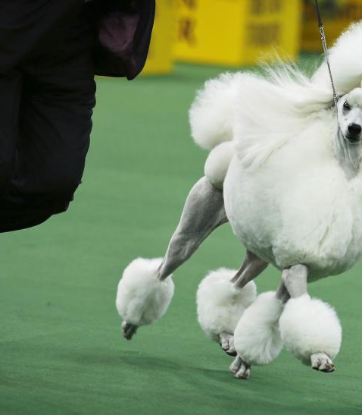
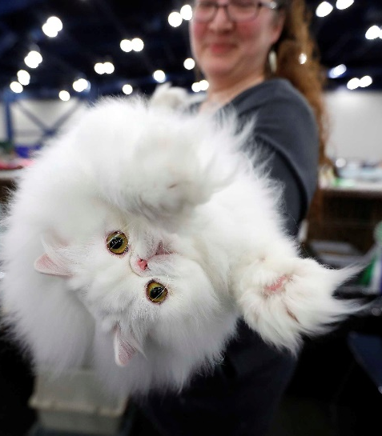
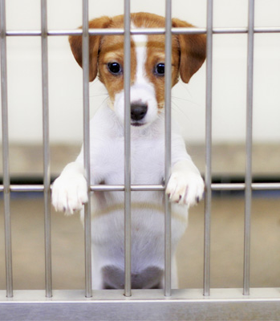
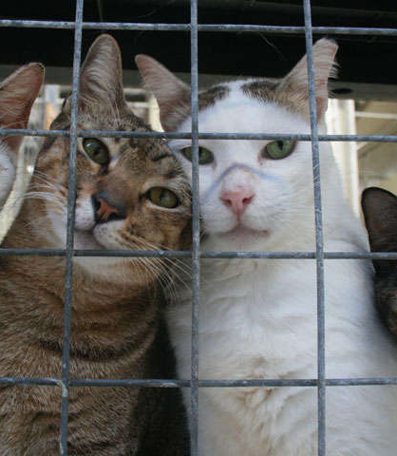
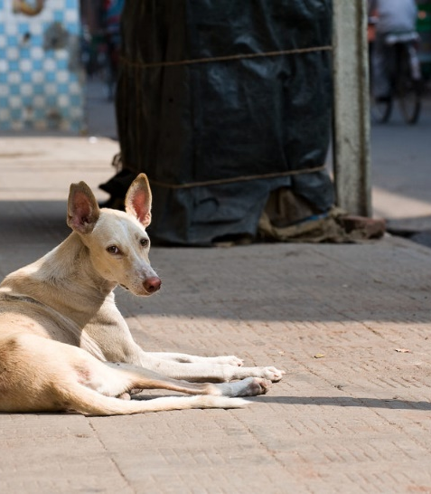
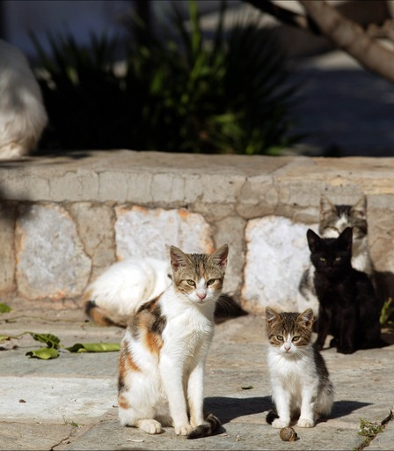
Motivacija
Broj pasa na svijetu:
900 milijuna
Broj mačaka na svijetu:
600 milijuna
IZVOR: The Humane Society. "Pets by the numbers." Web Accessed February 20, 2019.

Slide 3
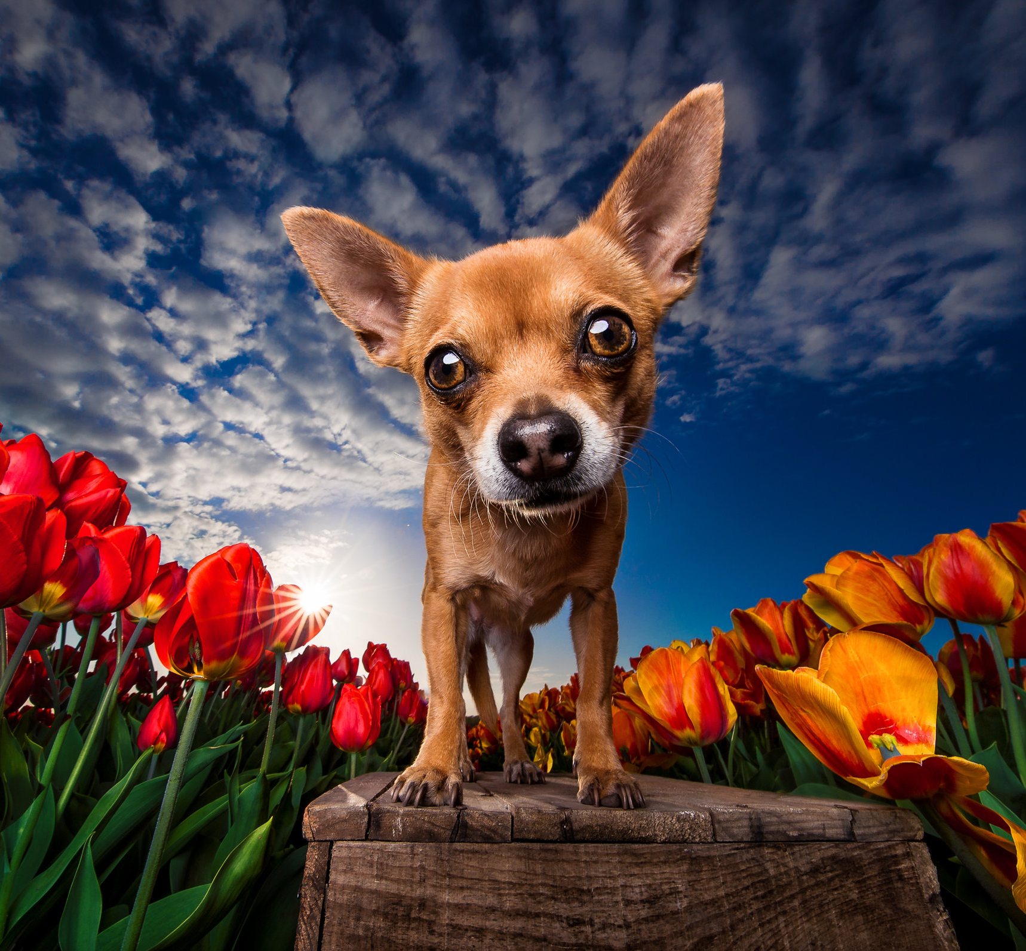

Sretne šapice
Udomljavanje
Psi
Mačke
Trgovina
Blog
O nama
Kontakt

Slide 4
Slijed projekta
1
2
3
Low-fidelity prototip
High-fidelity prototip (Figma)
Gatsby
4
Netlify
Headless CMS

Slide 5

Contentful
Content modelling
Content management
1
2
3
Content delivery
4

Slide 6




Content
Fetch content from delivery API
GraphQL
Gatsby
Hosting
Webhook notification to trigger builds
Netlify

Slide 7
Demo
Contentful
https://app.contentful.com/spaces/i28zogqkqary/entries?id=YdZkQI0VP8CH1eJX&contentTypeHidden=false&order.fieldId=updatedAt&order.direction=descending&displayedFieldIds=updatedAt&displayedFieldIds=author&already_authenticated=1

Slide 8
High – fidelity prototip
Figma

Slide 9

O nama
Naslovnica

Slide 10
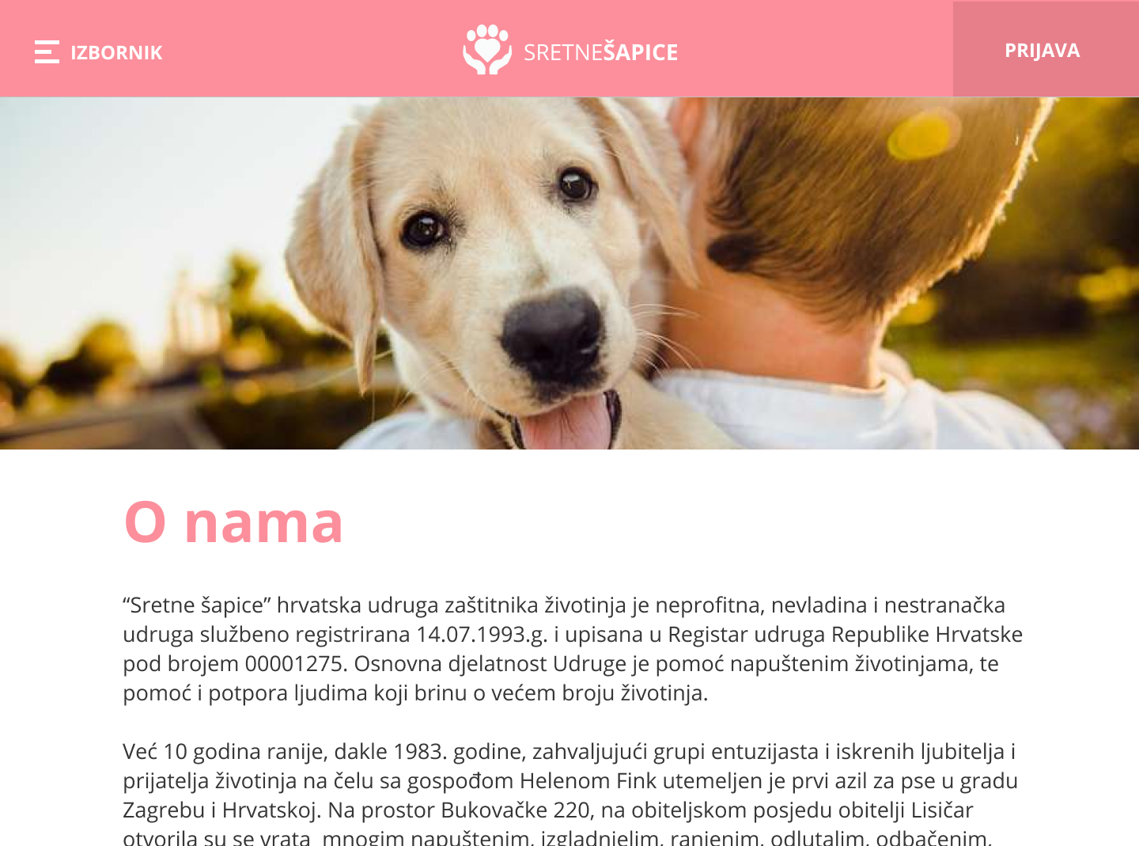
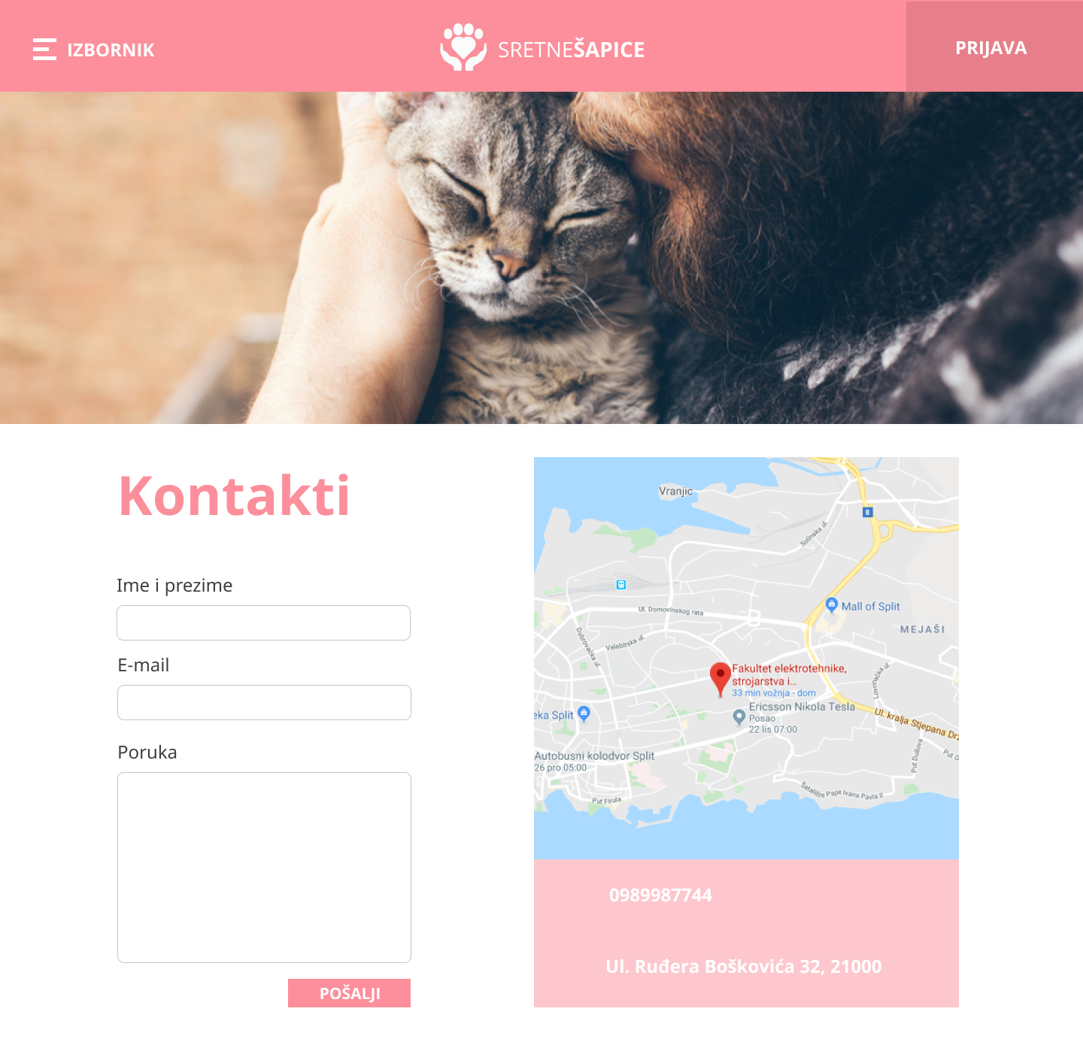
O nama
O nama
Kontakt

Slide 11
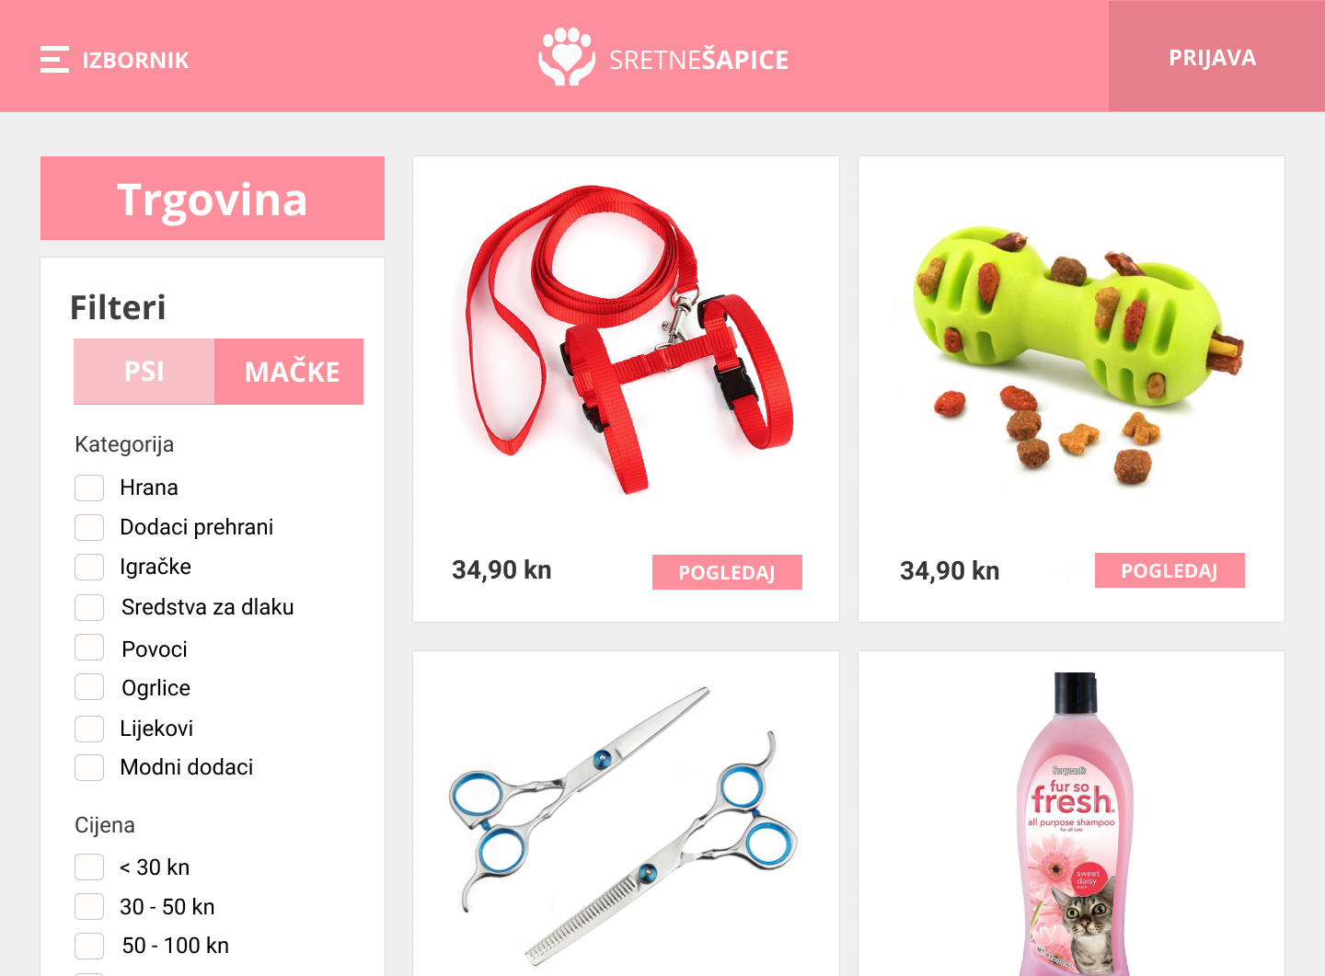
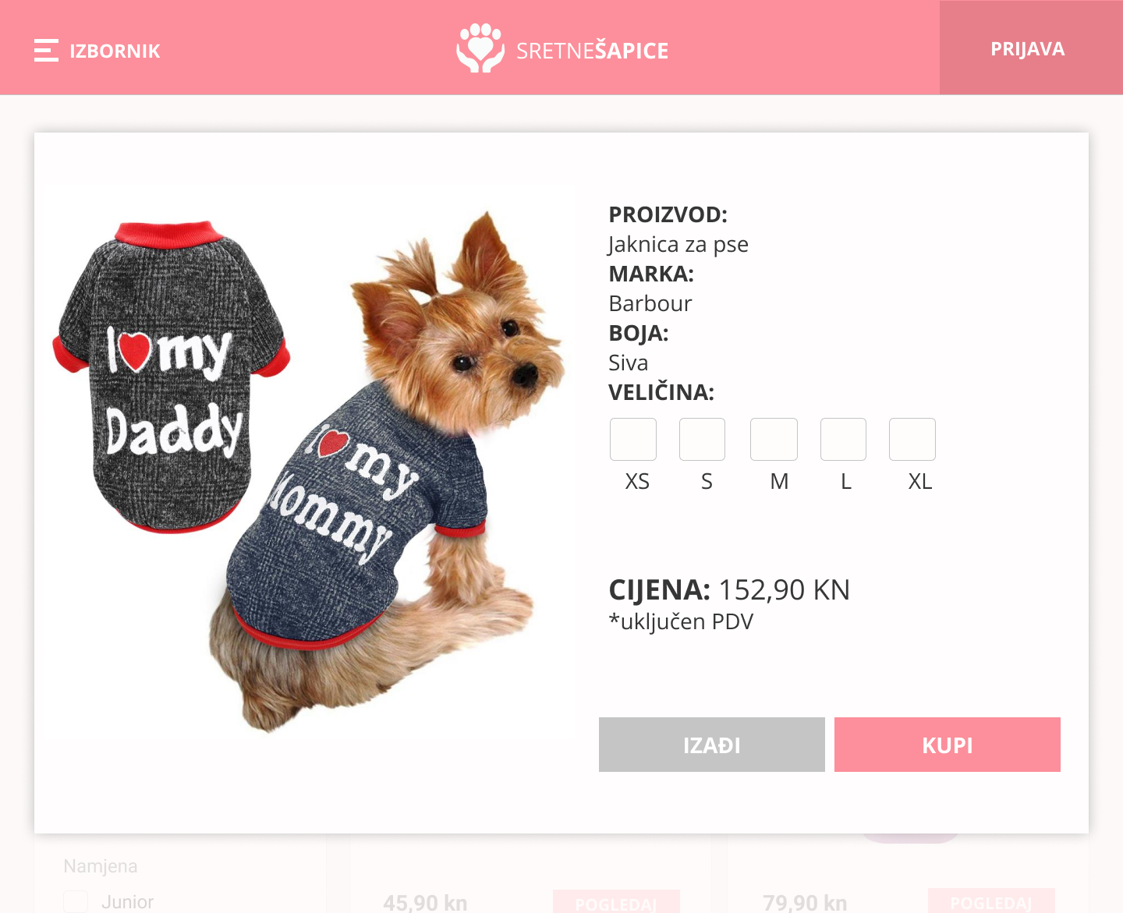
O nama
Trgovina

Slide 12
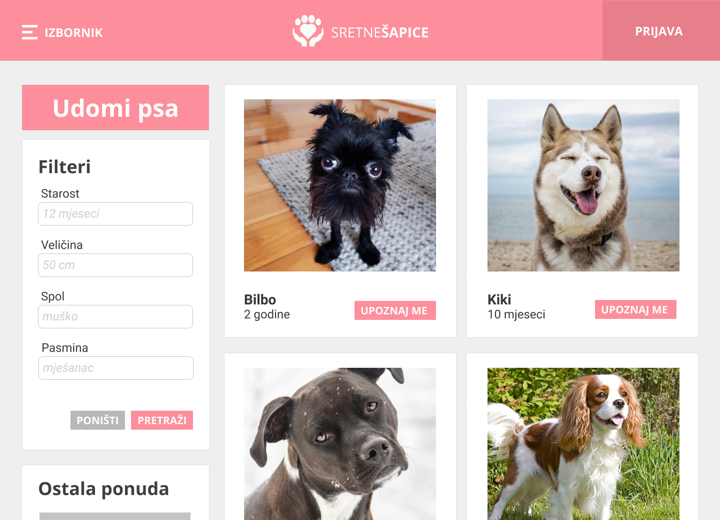
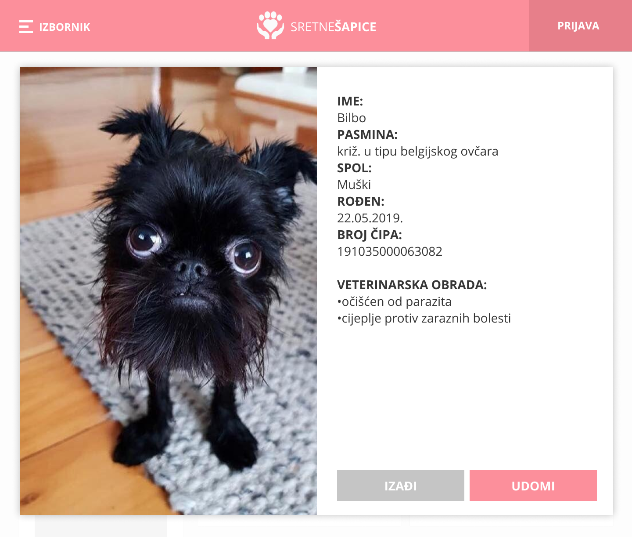
O nama
Udomi psa

Slide 13
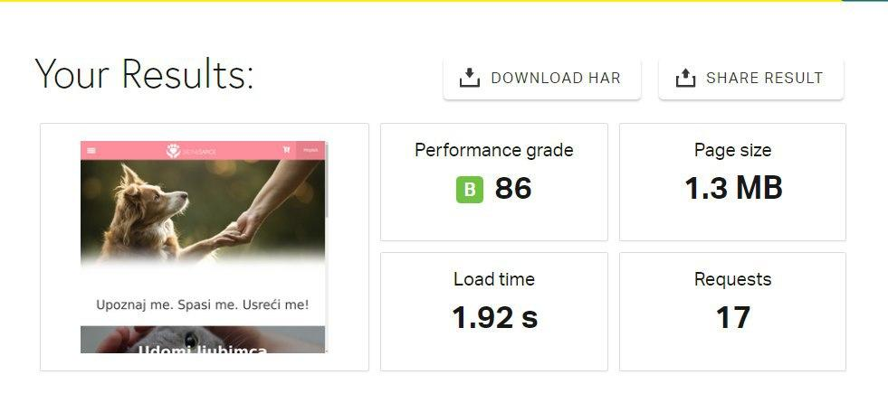
Performanse

Slide 14

Hvala na
pažnji!

Slide 15
Demo
SretneŠapice
https://sretne-sapicee.netlify.com/

